Slide 1
Theories of Motivation

Slide 2
Maslow’s Theory of Hierarchical Needs
Abraham Maslow postulated that a person will be motivated when all his needs are fulfilled. People do not work for security or money, but they work to contribute and to use their skills. He demonstrated this by creating a pyramid to show how people are motivated and mentioned that ONE CANNOT ASCEND TO THE NEXT LEVEL UNLESS LOWER-LEVEL NEEDS ARE FULFILLED. The lowest level needs in the pyramid are basic needs and unless these lower-level needs are satisfied people do not look at working toward satisfying the upper-level needs.

Slide 3
Below is the hierarchy of needs:
Physiological needs: are basic needs for survival such as air, sleep, food, water, clothing, sex, and shelter.
Safety needs: Protection from threats, deprivation, and other dangers (e.g., health, secure employment, and property)
Social (belongingness and love) needs: The need for association, affiliation, friendship, and so on.
Self-esteem needs: The need for respect and recognition.
Self-actualization needs: The opportunity for personal development, learning, and fun/creative/challenging work. Self-actualization is the highest-level need to which a human being can aspire.

Slide 4
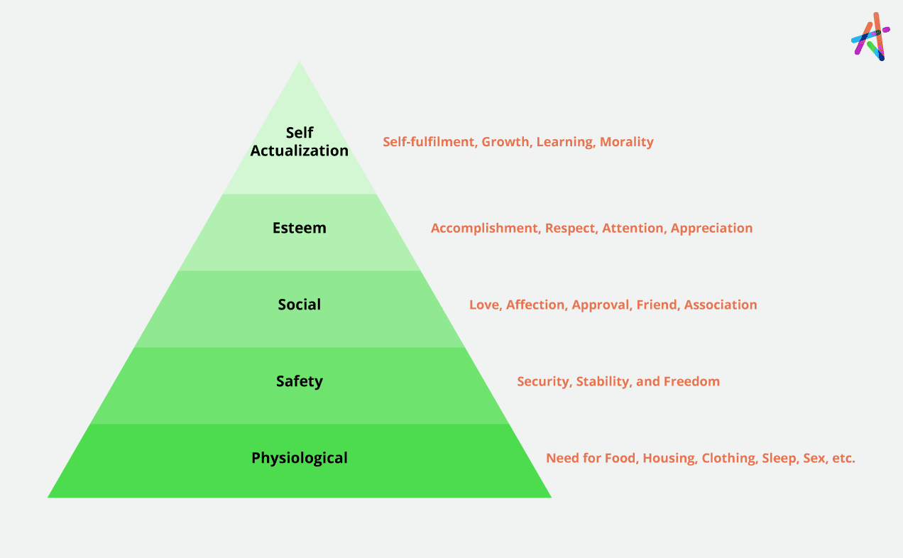

Slide 5
Incentive Theory
The theory determines that rewards or punishments influence employees' work behavior. Therefore, these are the primary motivators for individuals performing certain tasks and achieving specific results. For instance,

Slide 6
Bonus: It refers to the reward that is given to the employees for their exceptional performance.
Opportunity: It is a type of incentive given to individuals through paid training or continuing education to enhance their knowledge and build their skills.
Promotion: Providing a higher position or salary can make employees feel their importance and growth.
Paid off: Providing compensation for taking leave as additional holidays on emergency needs or planned trips can make employees feel satisfied.

Slide 7
Herzberg's Two-Factor Theory
The theory states that two factors influence satisfaction or dissatisfaction:
Hygiene Factors: Satisfaction can be influenced by factors like professional relations, policies, working environment, attitude of the supervisor. If these factors are fine, they can motivate employees and vice versa.
Motivators Factors: Motivating factors, including recognition, personal growth, achievements, career and responsibilities, are crucial for employees. Acknowledging these enhances job satisfaction.

Slide 8
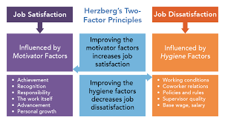

Slide 9
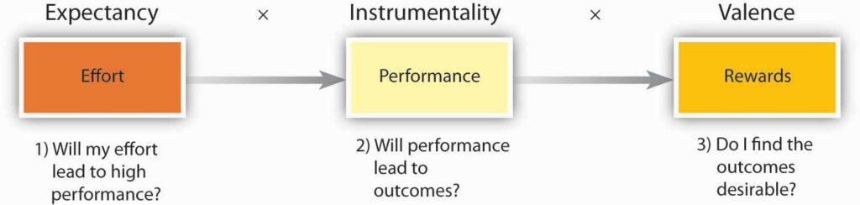
Expectancy Theory

Slide 10
Expectancy Theory
Emphasizes the relationship between efforts, performance expectations, and desirable rewards.

Slide 11
Expectancy theory based on three elements
Expectancy: the belief that your effort will result in your desired goal. This is based on your past experience, your self confidence and how difficult you think the goal is to achieve.
Instrumentality: the belief that you will receive a reward if you meet performance expectations.
Valence: the value you place on the reward.

Slide 12
There are several key elements that can influence valence.
Intrinsic valences (personal satisfaction, etc.)
Extrinsic valences (benefits, promotions, pay policies, etc.)
Negative valences (penalties, sanctions, etc.)

